Slide 1
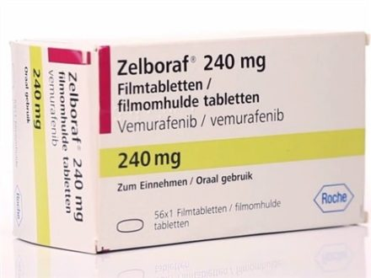
#202429 NDA workshop Vemurafenib (Zelboraf, Roche)
Dept. of Clinical Pharmacology & Therapeutics
Asan Medical Center
2018-03-02

Slide 2
Introduction
Zelboraf (vemurafenib) Tablet, 240 mg for the
treatment of unresectable or metastatic melanoma
with the BRAFV600 mutation as detected by an FDA
approved test

Slide 3
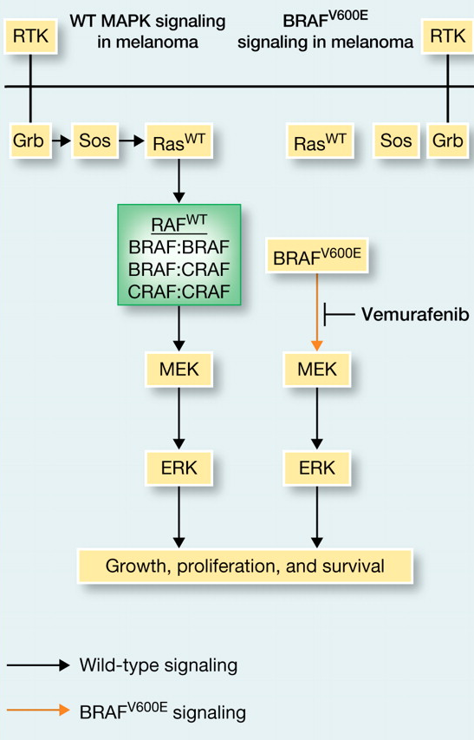
Introduction – metastatic melanoma
132,000 new cases of melanoma per year in US
9,500 deaths
Relapse rates are relatively high for late-stage disease
89% for stage IIIC
68% for stage IIIB
37% for stage IIIA
Stage IV has median survival of 9 months from diagnosis
What causes metastatic melanoma?
~50% of tumor have a mutation in BRAF
~80% of those mutations are V600E
16% are V600K and 3% are V600R
these mutations seem to arise early – often found in benign nevi
The same BRAF mutations are also found in other tumor types
132,000 new cases of melanoma per year in US
9,500 deaths
Relapse rates are relatively high for late-stage disease
89% for stage IIIC
68% for stage IIIB
37% for stage IIIA
Stage IV has median survival of 9 months from diagnosis
What causes metastatic melanoma?
~50% of tumor have a mutation in BRAF
~80% of those mutations are V600E
16% are V600K and 3% are V600R
these mutations seem to arise early – often found in benign nevi
The same BRAF mutations are also found in other tumor types

Slide 4
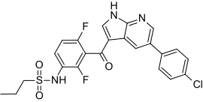
Introduction
BRAF inhibtor developed by Plexicon
and later Genentech
PLX4032 or Vemurafenib (V600E mutant Raf inhibitor)
Works well in vitro and in lab animals
Human trails begun 2008. Enrolled only patients with BRAF^{V600E}
Phase I: 16 patients with stage IV cancers
Median survival increased 9 → 15 months
Phase II: 132 patients with stage IV cancers
53% of patients responded. Similar increase in survival
Phase III: 675 patients with stage III or IV cancers
compared vemurafenib to dacarbazine
Stopped early. Dacarbazine patients moved to vemurafenib
FDA approval August 2011

Slide 6
Management of BRAF V600-Mutant Advanced Melanoma

Slide 7
Case 4: From the Practice of Dr Pavlick
A 60-year-old man s/p excised primary melanoma in 2005 presents with a persistent cough 4 years later
Workup reveals lung metastases from melanoma
BRAF V600E-mutant

Slide 8
In general, what is your most likely first- and second-line nonprotocol systemic treatment recommendation for a 60-year-old asymptomatic patient with low-volume lung metastases from BRAF V600E-mutant melanoma (assuming slow progression on first-line therapy)?
HD IL-2 → Ipilimumab
HD IL-2 → Vemurafenib
Ipilimumab → HD IL-2
Ipilimumab → Vemurafenib
Vemurafenib → HD IL-2
Vemurafenib → Ipilimumab
Other

Slide 9
In general, what is your most likely first- and second-line nonprotocol systemic treatment recommendation for a 60-year-old asymptomatic patient with low-volume lung metastases from BRAF V600E-mutant melanoma (assuming slow progression on first-line therapy)?
HD IL-2 → Ipilimumab
HD IL-2 → Vemurafenib
Ipilimumab → HD IL-2
Ipilimumab → Vemurafenib
Vemurafenib → HD IL-2
Vemurafenib → Ipilimumab
Other

Slide 10
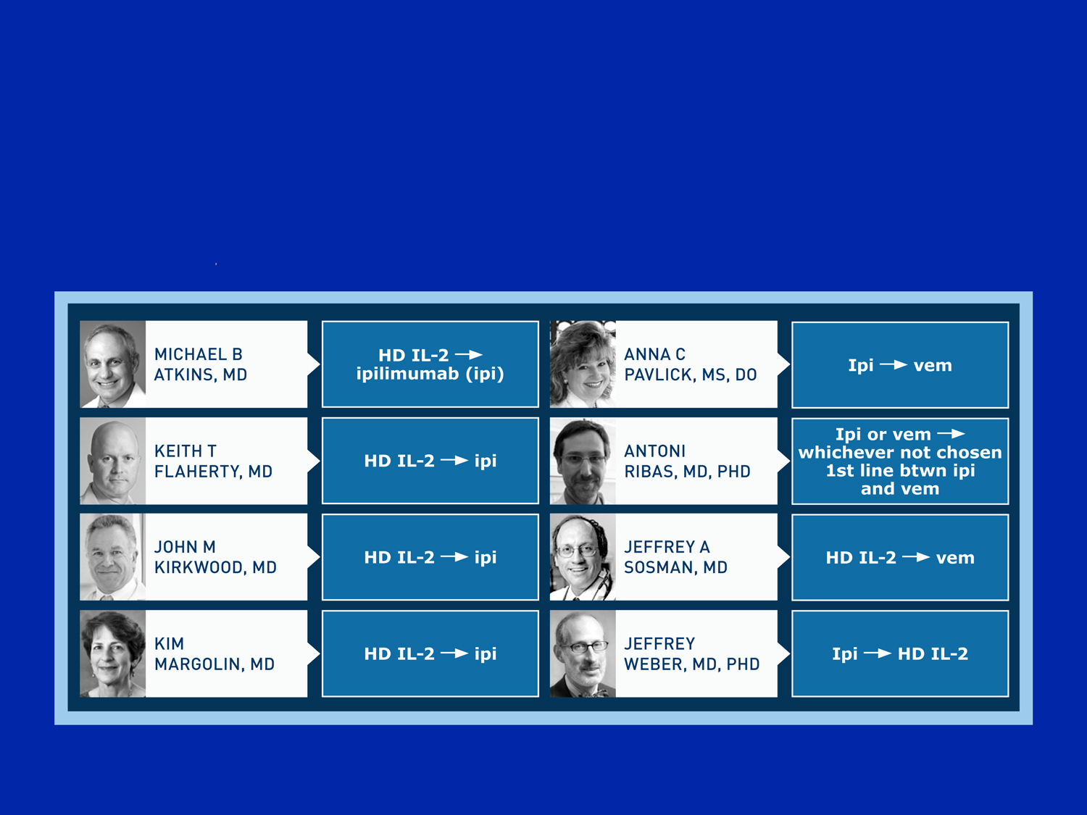
First- and second-line nonprotocol treatment for a 60 yo asymptomatic pt w/ low-volume lung mets from BRAF V600E-mutant melanoma (assuming slow progression on first-line therapy)?

Slide 11
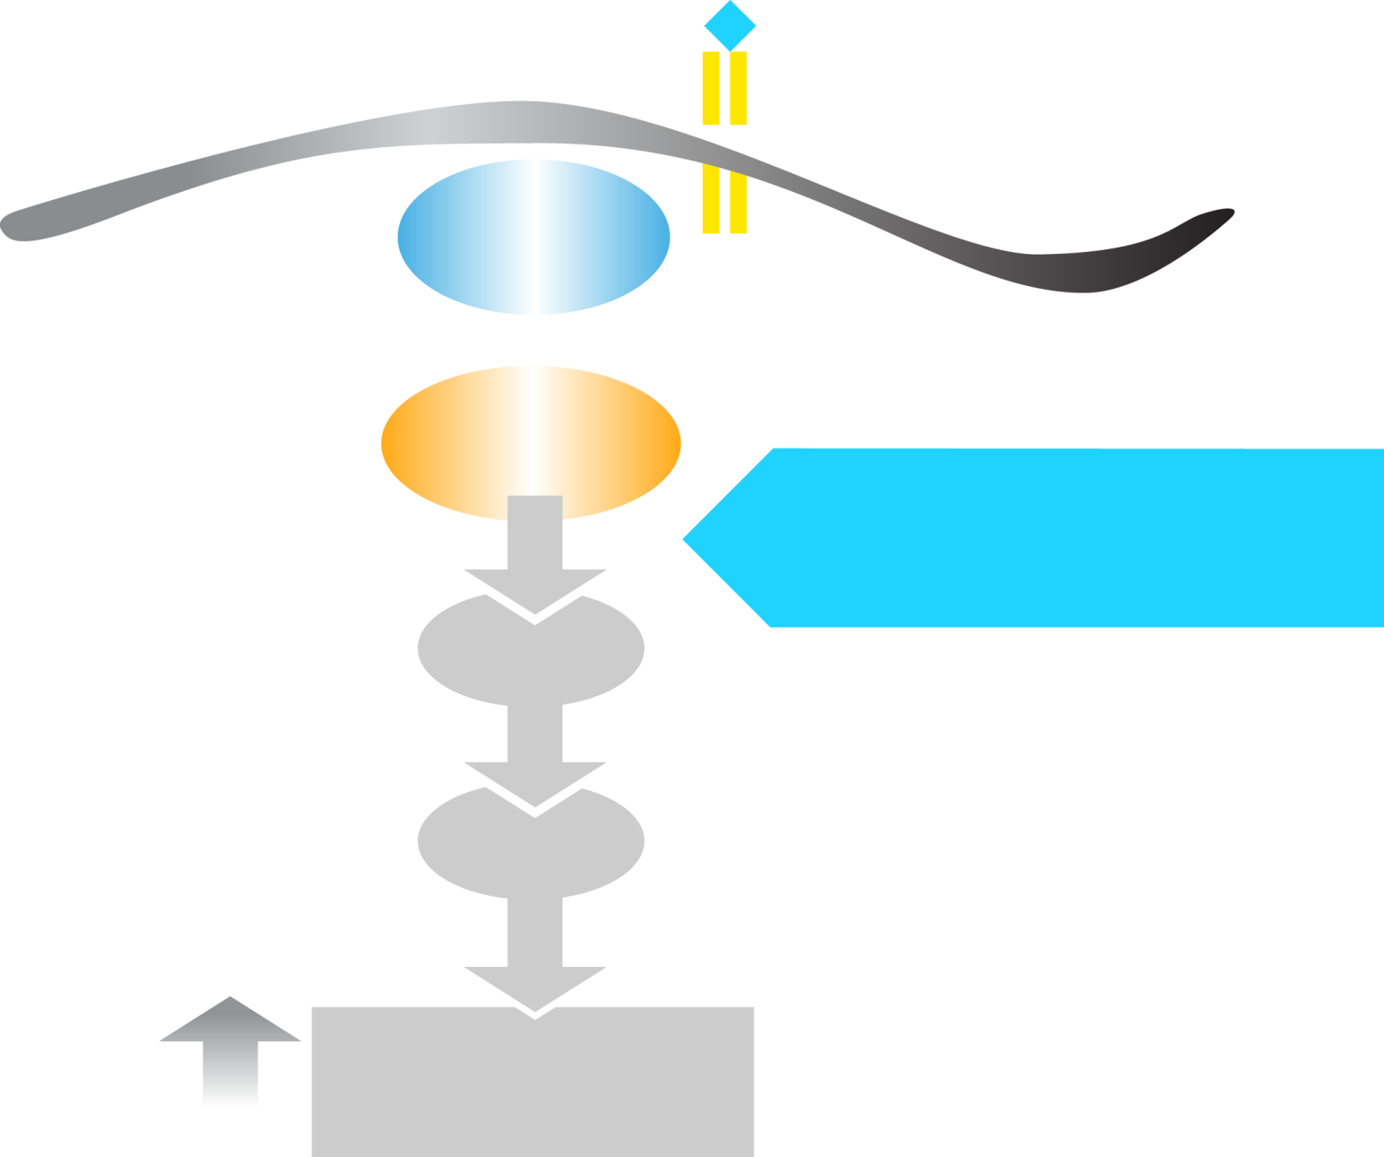
Vemurafenib Inhibits BRAF^{V600E} Kinase
RTK
RAS
40-60% of melanomas
BRAF^{V600E}
VEMURAFENIB
ATP
MEK
ATP
ERK
Cellular Proliferation
Chapman PB et al. Proc ASCO 2011;Abstract LBA4.

Slide 12
Updated overall survival (OS) results for BRIM-3, a phase III randomized, open-label, multicenter trial comparing BRAF inhibitor vemurafenib (vem) with dacarbazine (DTIC) in previously untreated patients with BRAF^{V600E}-mutated melanoma.
Chapman PB et al.
Proc ASCO 2012;Abstract 8502.

Slide 13
BRIM3: Vemurafenib Front-Line Trial – Phase III Study Design
Screening
BRAF^{V600E} mutation
Stratification:
Stage
ECOG PS (0 vs 1)
LDH (elevated vs normal)
Geographic region
Vemurafenib
960 mg PO bid
(n = 337)
Randomization
n = 675
Dacarbazine
1000 mg/m² IV q3wk
(n = 338)
Co-primary endpoints were OS and PFS

Slide 14
Updated overall survival (OS) results for BRIM-3, a phase III randomized, open-label, multicenter trial comparing BRAF inhibitor vemurafenib (vem) with dacarbazine (DTIC) in previously untreated patients with BRAF^{V600E}-mutated melanoma. (Chapman PB et al. Proc ASCO 2012;Abstract 8502.)

Slide 15
BRIM3: Vemurafenib Front-Line Trial – Phase III Study Design
Screening
BRAF^{V600E} mutation
Stratification:
Stage
ECOG PS (0 vs 1)
LDH (elevated vs normal)
Geographic region
Vemurafenib
960 mg PO bid
(n = 337)
Randomization
n = 675
Dacarbazine
1000 mg/m² IV q3wk
(n = 338)
Co-primary endpoints were OS and PFS

Slide 16
BRIM3: Best Tumor Response by Individual Patient
Vemurafenib: 48.4% confirmed objective response (ASCO 2011)
>100
M1c
50
57.0% confirmed objective response (ASCO 2012)
Percent Change From Baseline in Sum of Tumor Diameters
0
-50
-100
Dacarbazine
5% confirmed objective response (NEJM 2011)
8.6% confirmed objective response (ASCO 2012)
From The New England Journal of Medicine, Chapman PB et al, Improved Survival with Vemurafenib in Melanoma with BRAF V600E Mutation, Volume 364, Pages 2507-16. Copyright © 2013 Massachusetts Medical Society. Reprinted with permission from Massachusetts Medical Society
Chapman PB et al. Proc ASCO 2012;Abstract 8502.

Slide 17
BRIM3: Best Tumor Response by Individual Patient
Vemurafenib: 48.4% confirmed objective response (ASCO 2011)
>100
M1c
Percent Change From Baseline in Sum of Tumor Diameters
57.0% confirmed objective response (ASCO 2012)
50
0
-50
-100
Dacarbazine
5% confirmed objective response (NEJM 2011)
8.6% confirmed objective response (ASCO 2012)
From The New England Journal of Medicine, Chapman PB et al, Improved Survival with Vemurafenib in Melanoma with BRAF V600E Mutation, Volume 364, Pages 2507-16. Copyright © 2013 Massachusetts Medical Society. Reprinted with permission from Massachusetts Medical Society
Chapman PB et al. Proc ASCO 2012;Abstract 8502.

Slide 18
BRIM3: Overall Survival at February 1, 2012 Cutoff, Censored at Crossover
 | Vemurafenib (n = 337) | Dacarbazine (n = 338) | Hazard ratio | Post-hoc p-value
Overall survival | 13.6 mo | 9.7 mo | 0.70 | <0.001
Chapman PB et al. Proc ASCO 2012;Abstract 8502.

Slide 19
Efficacy of Vemurafenib in BRAFV600K Mutation-Positive Melanoma Disease – Results from the Phase 3 Clinical Study BRIM3
GA McArthur, A Hauschild, C Robert, J Larkin, JB Haanen, A Ribas, D Hogg, O Hamid, P Ascierto, A Testori, P Lorigan, R Dummer, JA Sosman, K Flaherty, M Yin, I Caro, F Shieh, R Schilling, K Trunzer, P Chapman
Society for Melanoma Research, November 8-11, 2012, Hollywood, California

Slide 20
BRIM3: Summary of Efficacy Data by BRAF Mutation Genotype
 | BRAF V600E |  | BRAF V600K
 | Dacarbazine | Vemurafenib | Dacarbazine | Vemurafenib
Median OS | 10.0 mos | 13.3 mos | 7.6 mos | 14.5 mos
 | Hazard ratio: 0.75 |  | Hazard ratio: 0.43
Median PFS | 1.6 mos | 6.9 mos | 1.7 mos | 5.9 mos
 | Hazard ratio: 0.39 |  | Hazard ratio: 0.30
Best ORR | 11% | 59% | 4% | 45%
 | Odds ratio: 11.2 |  | Odds ratio: 19.2
Comparable effects with vemurafenib in BRAF V600E and BRAF V600K mutation-positive disease
McArthur GA et al. Society for Melanoma Research 2012.

Slide 21
Selected Adverse Events (% of Patients)
 | BRAF V600E (n = 295) | BRAF V600K (n = 33)
Total patients with at least 1 AE | 100% | 100%
Arthralgia | 58% | 39%
Rash | 42% | 39%
Fatigue | 45% | 58%
Photosensitivity | 41% | 36%
Cutaneous SCC | 19% | 24%
Keratoacanthoma | 10% | 21%
Skin papilloma | 29% | 27%
Nausea | 40% | 24%
McArthur GA et al. Society for Melanoma Research 2012.

Slide 22
Case 5: From the Practice of Dr Pavlick
An 87-year-old man s/p resected Stage IIIC melanoma in 2011
Presents 10/2012 with decreased appetite, weight loss, abdominal fullness
Workup reveals multiple small lung mets and several large liver mets from melanoma
LDH: 3500
BRAF V600E m+
Vemurafenib
Dramatic response, resolution of symptoms
Dose reduction for Grade 3 rash and itching
On treatment 5 months with excellent QOL
Grand mal seizure
Innumerable hemorrhagic brain mets

Slide 23
Are there situations in which you would delay local treatment with radiation therapy for brain metastases and instead administer vemurafenib for a patient with a BRAF V600E-positive tumor?
Yes
No
I don’t know

Slide 24
Are there situations in which you would delay local treatment with radiation therapy for brain metastases and instead administer vemurafenib for a patient with a BRAF V600E-positive tumor?
Yes
No
I don’t know

Slide 25
Chemotherapy in the Management of Advanced Melanoma

Slide 26
Case 6: From the Practice of Dr Flaherty
A 41-year-old with a history of excision/adjuvant interferon for primary melanoma (2008) presents with lung and liver mets, pleural effusion in 2011
BRAF V600E m+
Vemurafenib (7/2011)
9/2011: 80% reduction in lung, liver, lymph nodes
Marked reduction in pleural effusion
HD IL-2 initiated (14/14) w/o progression on vemurafenib
1 month later: Increase in size of mets, new mets
Carbo/paclitaxel

Slide 28

Asan Medical Center
Dept. of CPT
Data Management Overview
PDF CRF
Process
Statistical Analysis Overview
Process
Contents

Slide 29
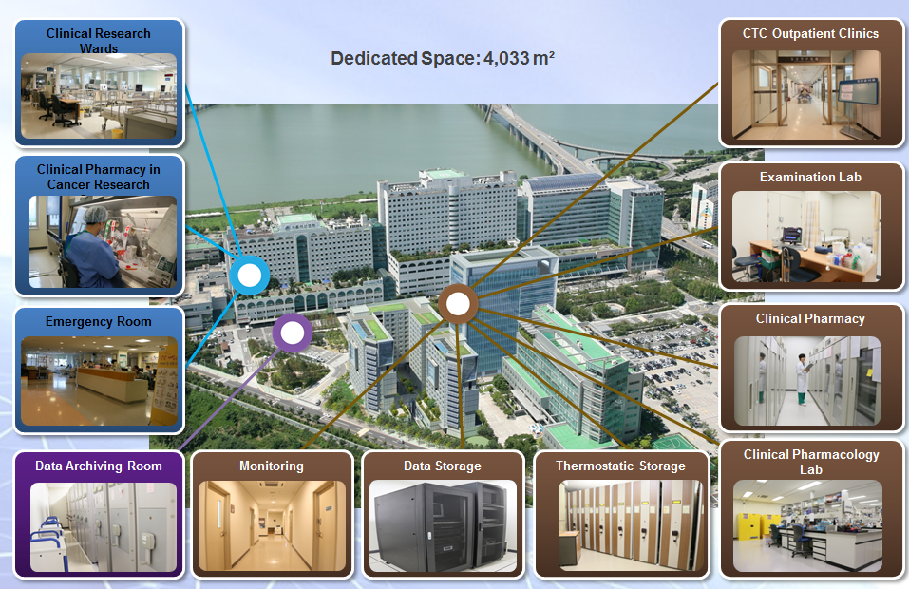
Clinical Trial Center

Slide 30
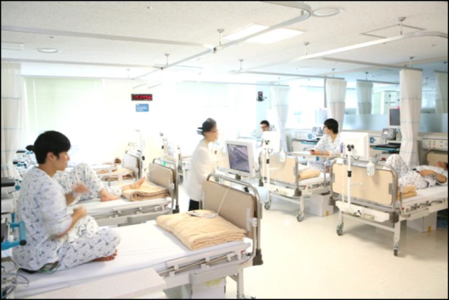

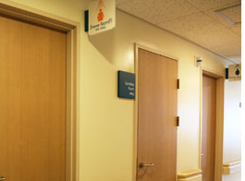
Phase I Unit
Healthy volunteer study
24 exclusive bed with intensive patient monitoring
Central monitoring system
Telemetry system
Data transfer to PC (24 set)
Connection to EMR system
Convenient Facilities
Each assigned bed and locker
Two bathrooms and two restrooms in a confined ward
Cable TV, nurse call bell, monitoring equipment (Bedside)
Volunteer lounge

Slide 31


Experiences
Phase I Trials
NME first-in-human/Tolerability
Comparative PK study
Drug interaction study
Food interaction study
Formulation bioequivalence
PD equivalence
Population PK/PD study
Special population
PK/PD simulation study
Bioequivalence study

Slide 32
Experiences of Phase I Trials
Types | 2010 | 2011 | 2012 | 2013 | 2014 | 2015 | 2016 | 2017 | Total
Phase I Trial
Comparative PK Study | 1 | 1 | 4 | 2 | 3 | . | 1 | 1 | 13
Drug Interaction Study | 2 | 3 | 2 | 6 | 3 | 1 | 1 | 1 | 19
Food Interaction Study | 1 | 3 | 1 | 1 | . | 1 | . | . | 7
Formulation BE Study | . | 1 | . | 1 | . | 1 | . | 1 | 4
NME First in Human/Tolerability | 1 | 1 | 6 | 5 | 2 | 5 | 1 | 1 | 22
PD Equivalence | . | . | . | 1 | . | . | . | . | 1
Total | 5 | 9 | 13 | 16 | 8 | 8 | 3 | 4 | 66

Slide 33
Data Management & Statistical Analysis Staff
Data Management Direct (DMD)
Bae, Kyun-Seop, MD, PhD
Data Management Manager (DMM)
Kim, Eun Na, MD
Statistician Manager
Lim, Hyeong-Seok, MD, PhD
IT Management
Han, Sung Pil, MD, PhD
Clinical Data Manager (CDM)
Cho, Yong Soon, MD, PhD
Han, Sung Pil, MD, PhD
Yoon, Seok Kyu, MD
Kim, Hyung Sub, MD, PhD
Database Administrator (DBA)
Clinical Data Associate (CDA)
Quality Check Person(QCP)
Lee, Shi Hyang, RN
Kim, Min Jeong, RN
Kim, Soyoung, RN
Jeong, Hye Rin, RN
Statistician
Cho, Yong Soon, MD, PhD
Han, Sung Pil, MD, PhD
Yoon, Seok Kyu, MD
Kim, Hyung Sub, MD, PhD

Slide 34
PDF CRF
No web server
No DB server
No IT personnel
No programmer
별도의 웹서버가 필요없이 모두 로컬 컴퓨터에서 작업이 이루어집니다.
Sql 등을 사용하지 않기 때문에 데이타베이스 서버가 필요 없습니다.
서버 관리 등에 필요한 IT 인력이 필요로 하지 않습니다.
서버 관리, DB 관리, CRF 개발 등을 위한 프로그래머를 필요로 하지 않습니다.

Slide 35
History of PDF CRF
2016-08
기본 R script 개발 완료
2016-09
- PDF CRF SOP 제정
- PDF CRF IRB 신규제출
2017
- 임상시험 3건 수행
2018
- 임상시험 1건 예정
Notes:
2016.08
기본 R Script 개발 완료
2016.09.01
PDF CRF SOP 제정
2016.09.23
PDF CRF IRB 신규 제출

Slide 36
Experiences of PDF CRF
Types | 2016 | 2017 | 2018 | Total
PDF CRF | 1 | 2 | 1 | 4
Total | 1 | 2 | 1 | 4
Types | 2016 | 2017 | 2018 | Total
Audit | - | 1 | - | 1
Total |  | 1 |  | 1

Slide 37
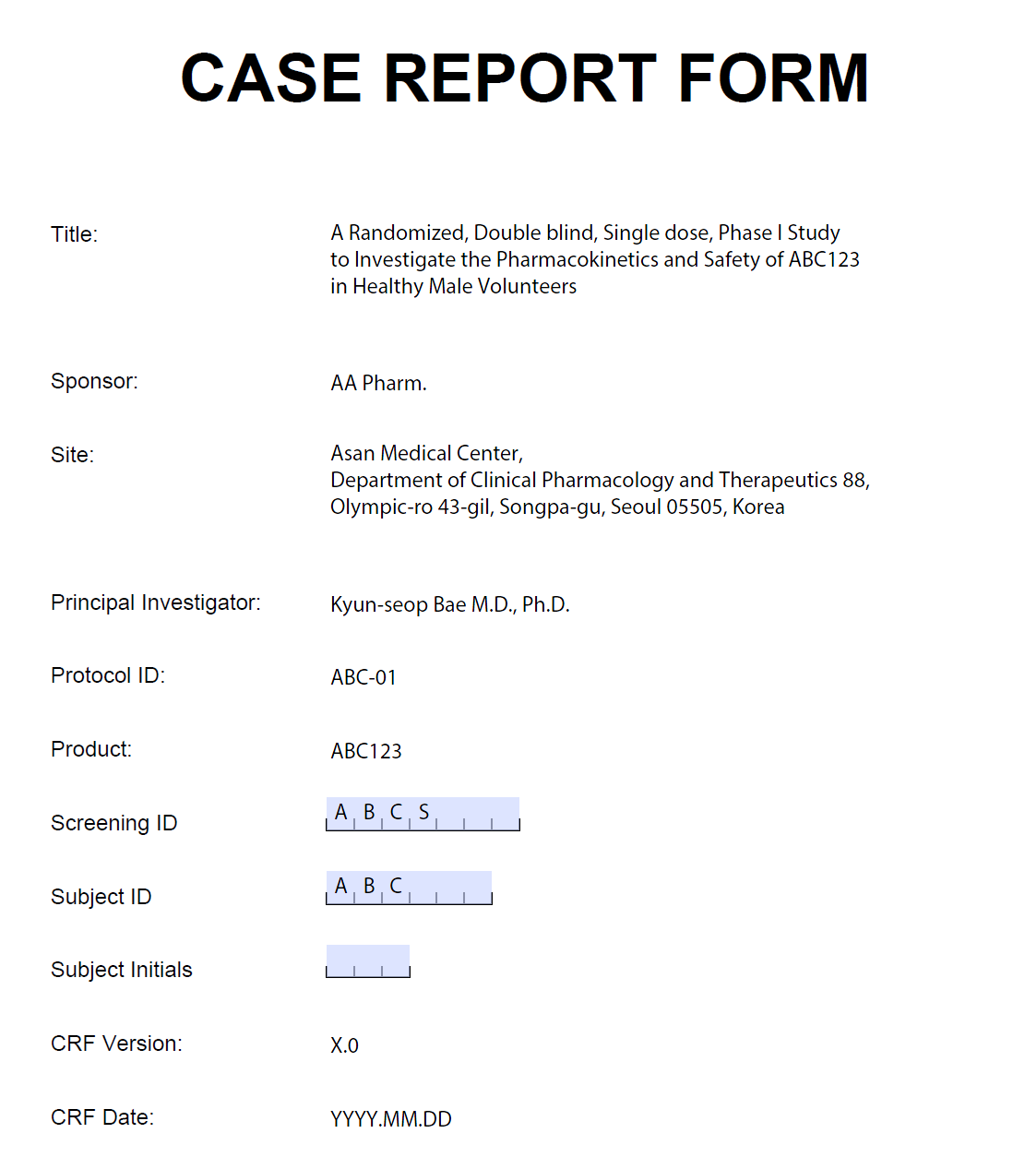

Slide 38
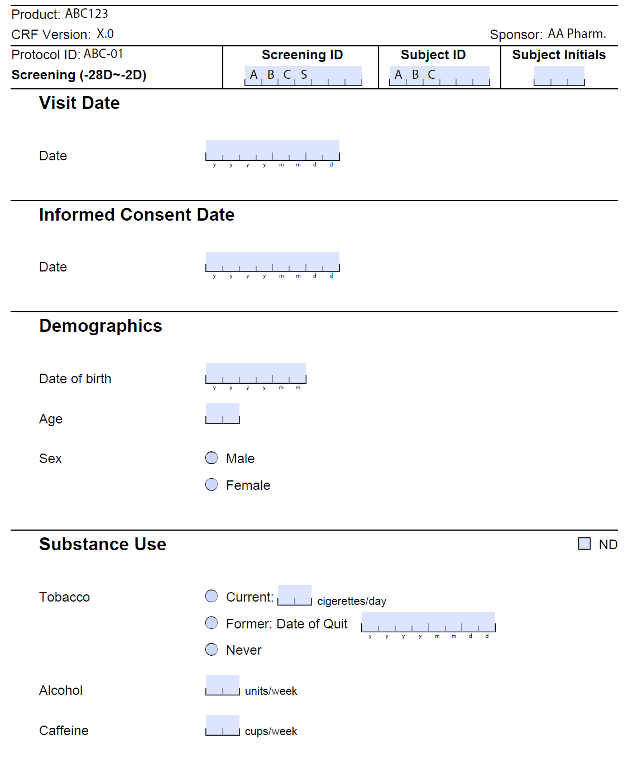

Slide 39
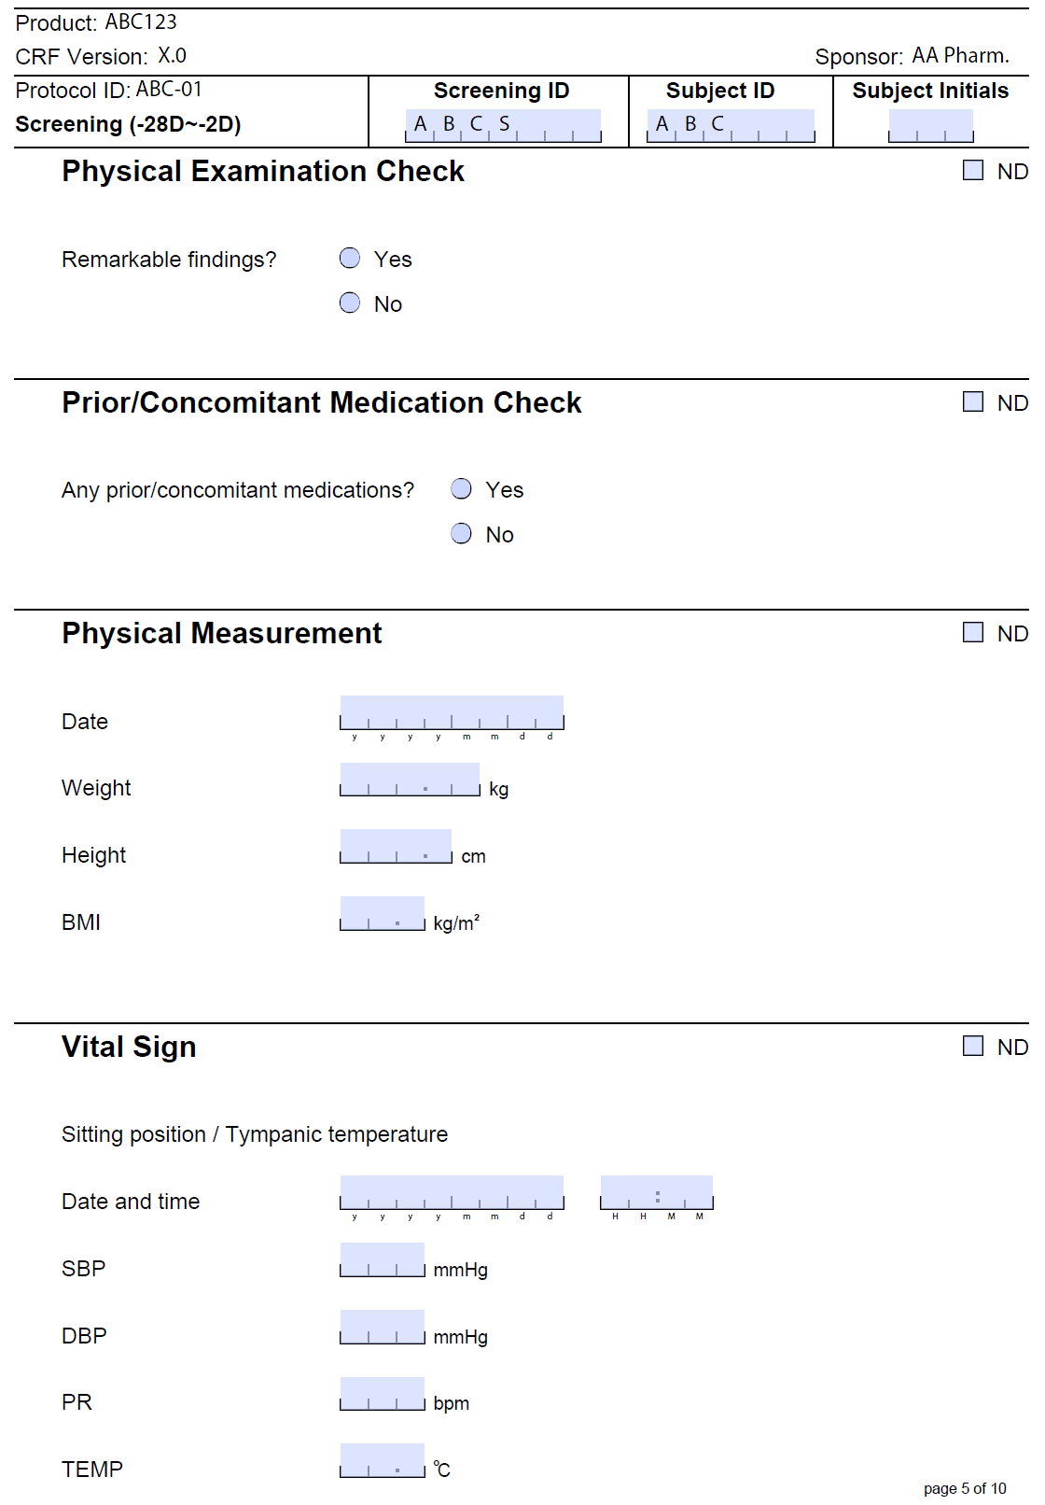

Slide 40
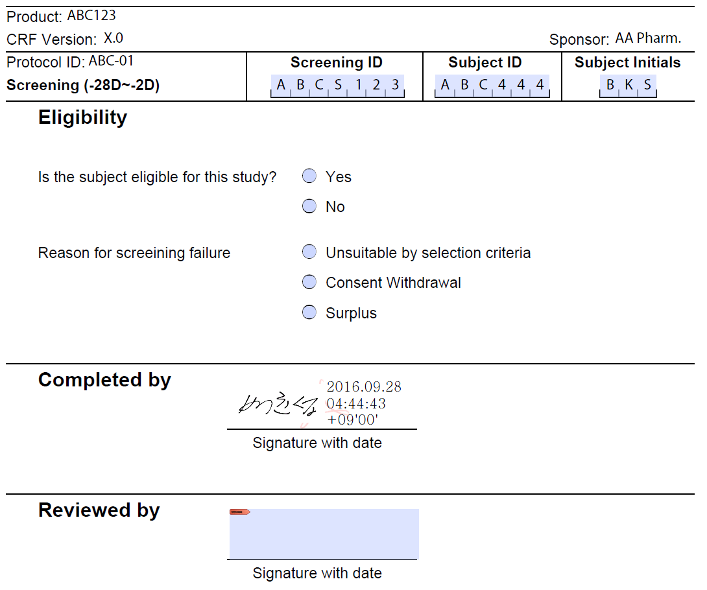

Slide 41
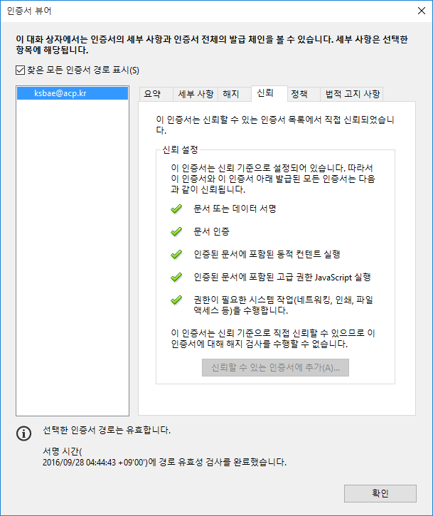

Slide 42
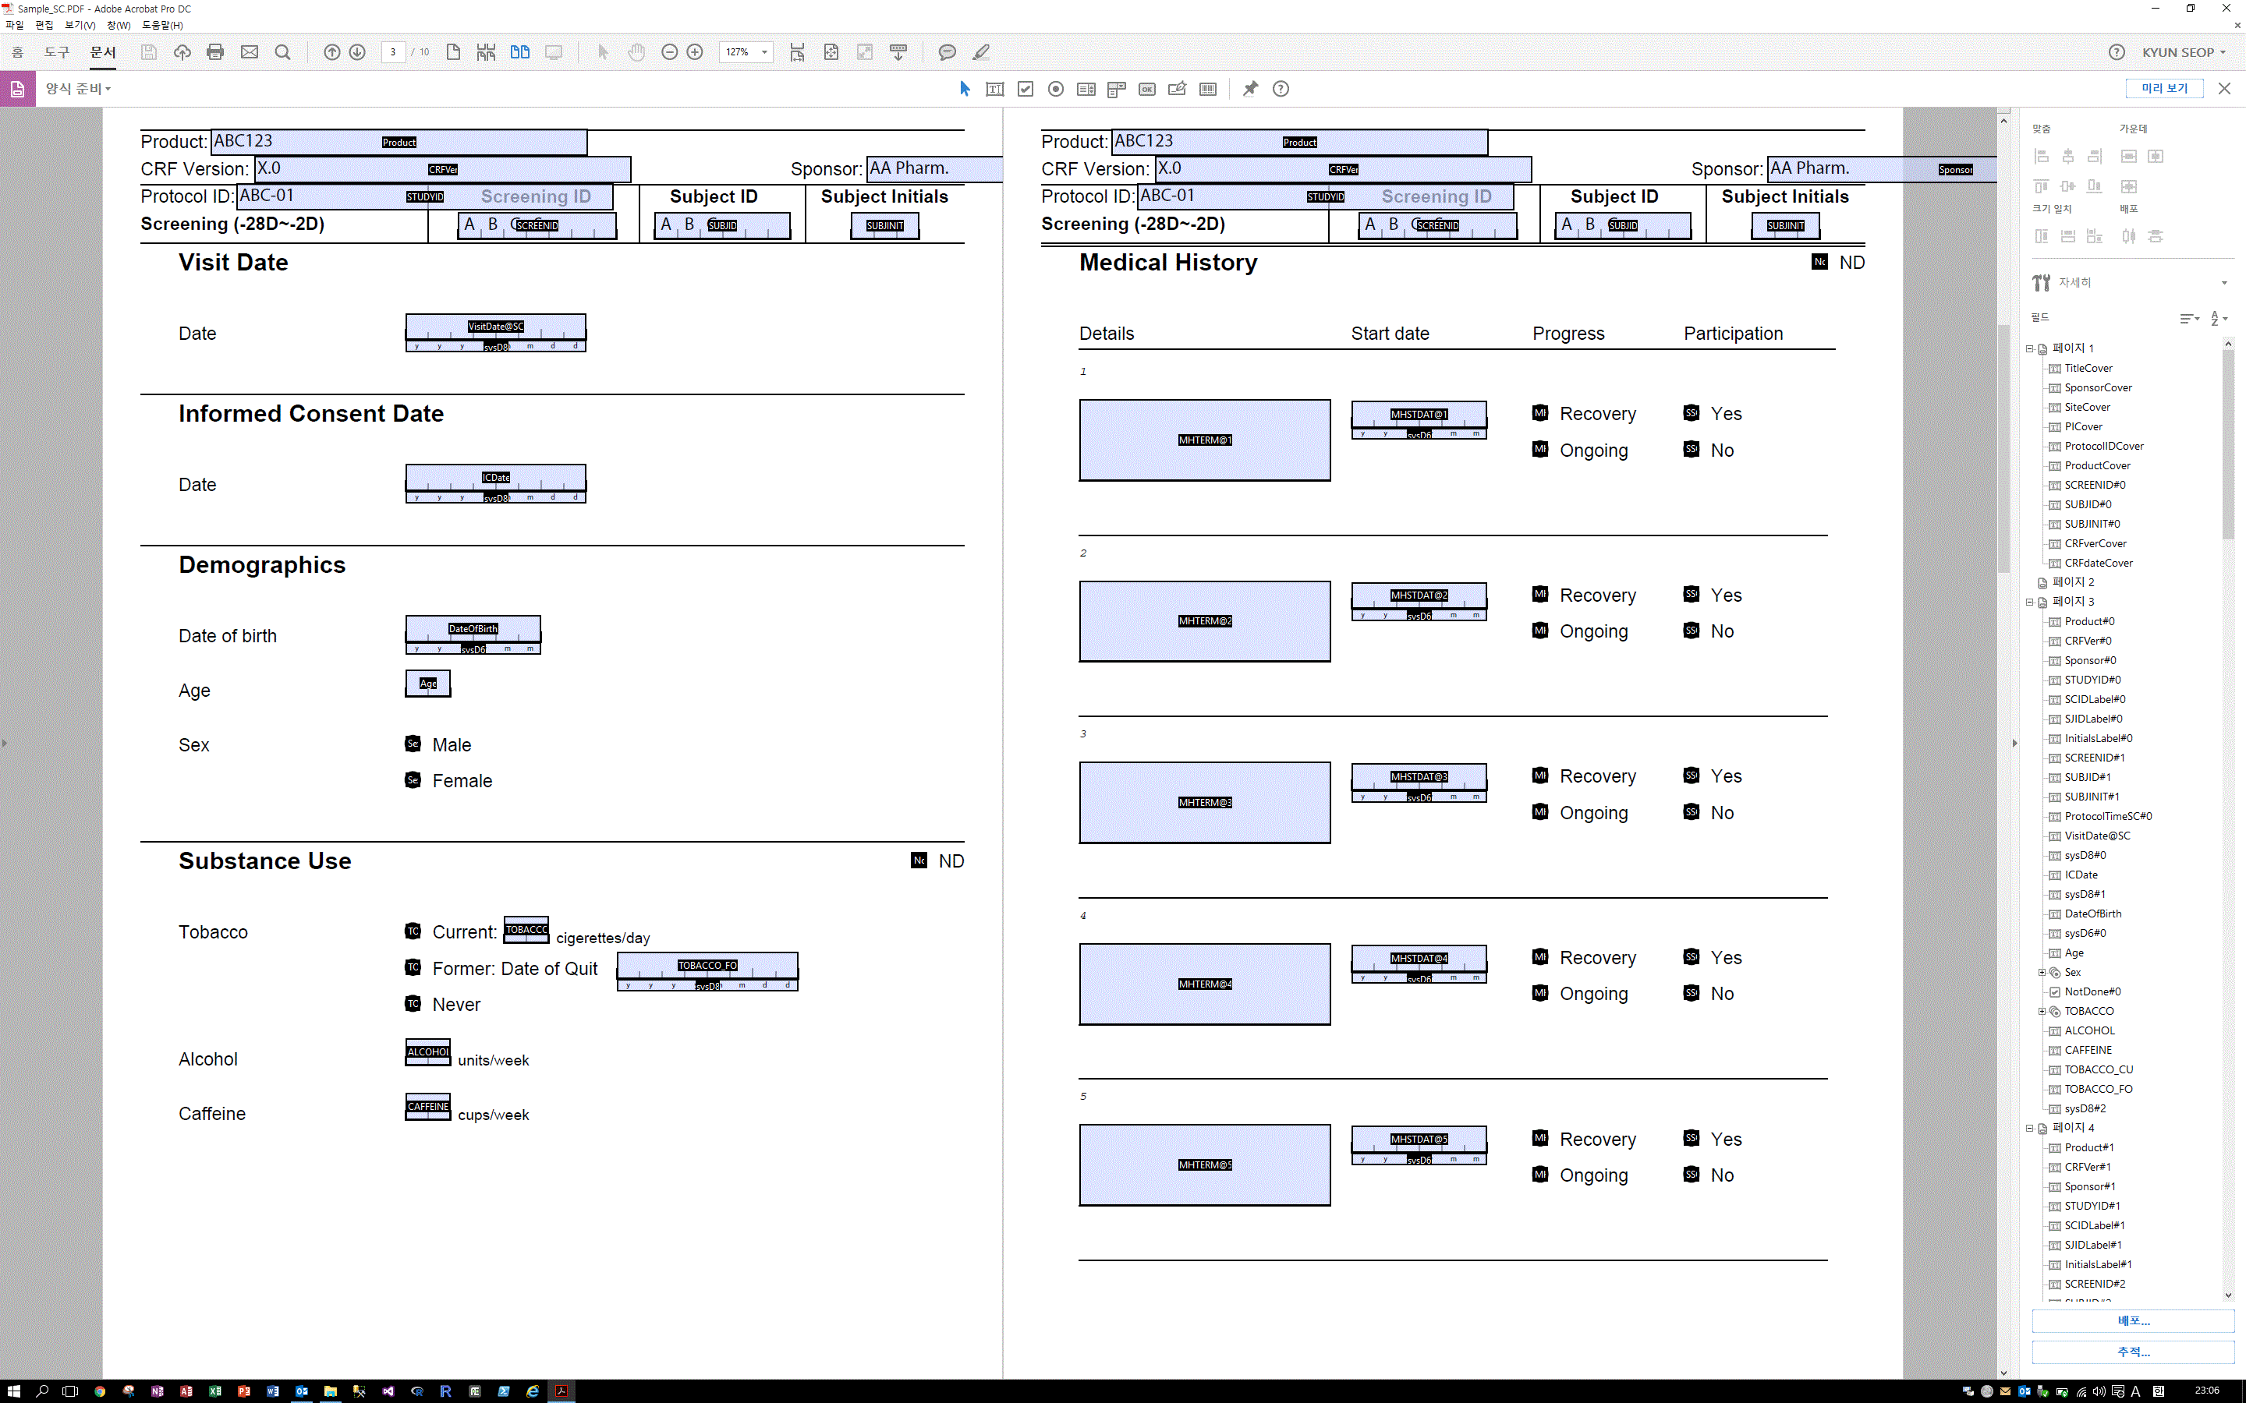

Slide 43
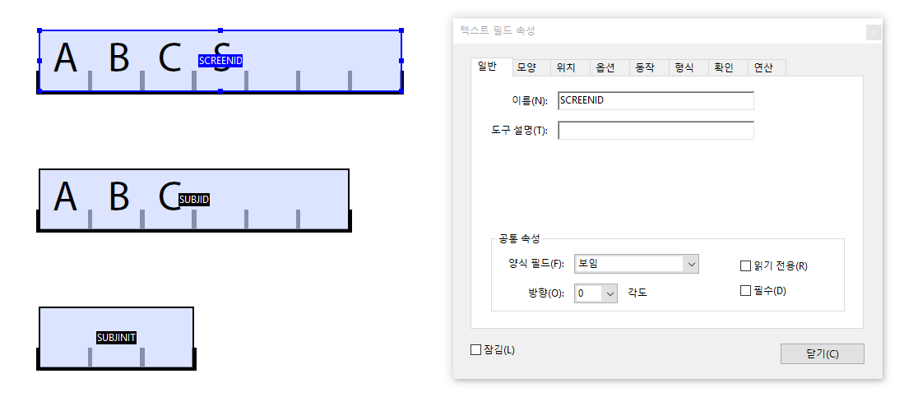

Slide 44
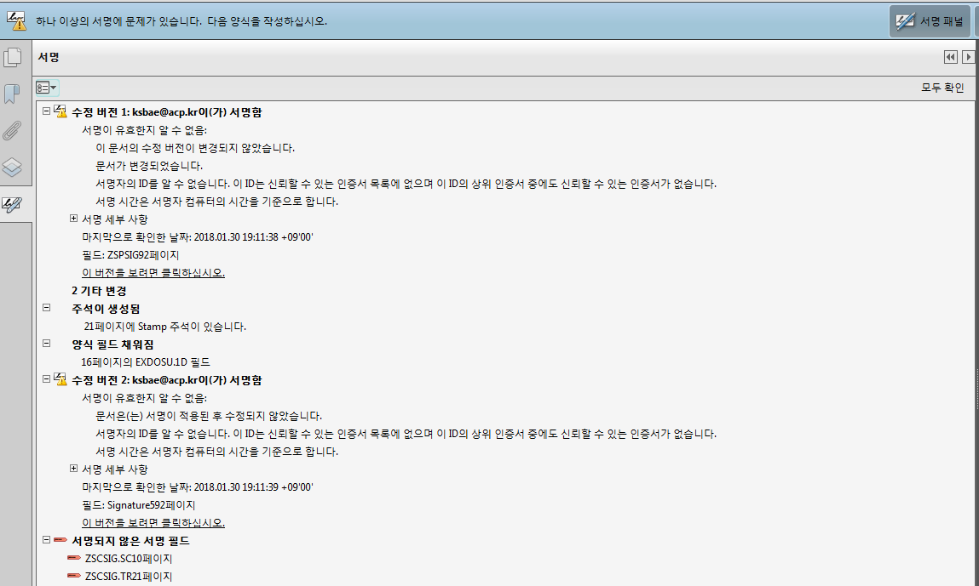

Slide 45
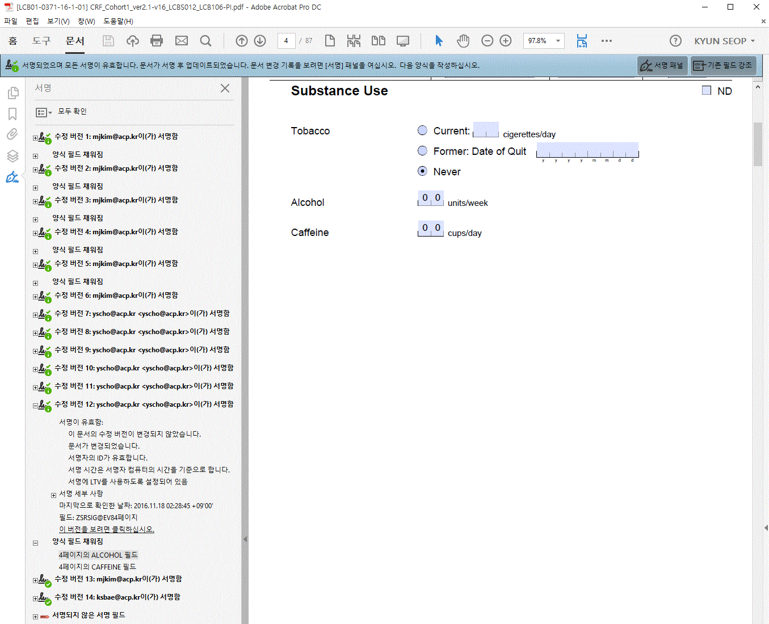
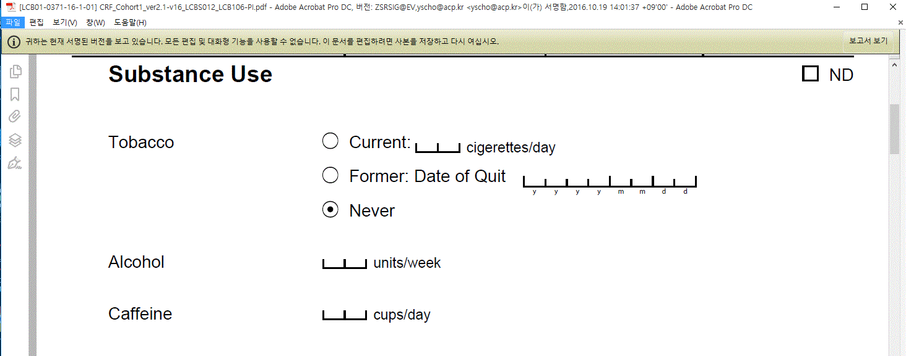

Slide 46
Demo

Slide 47
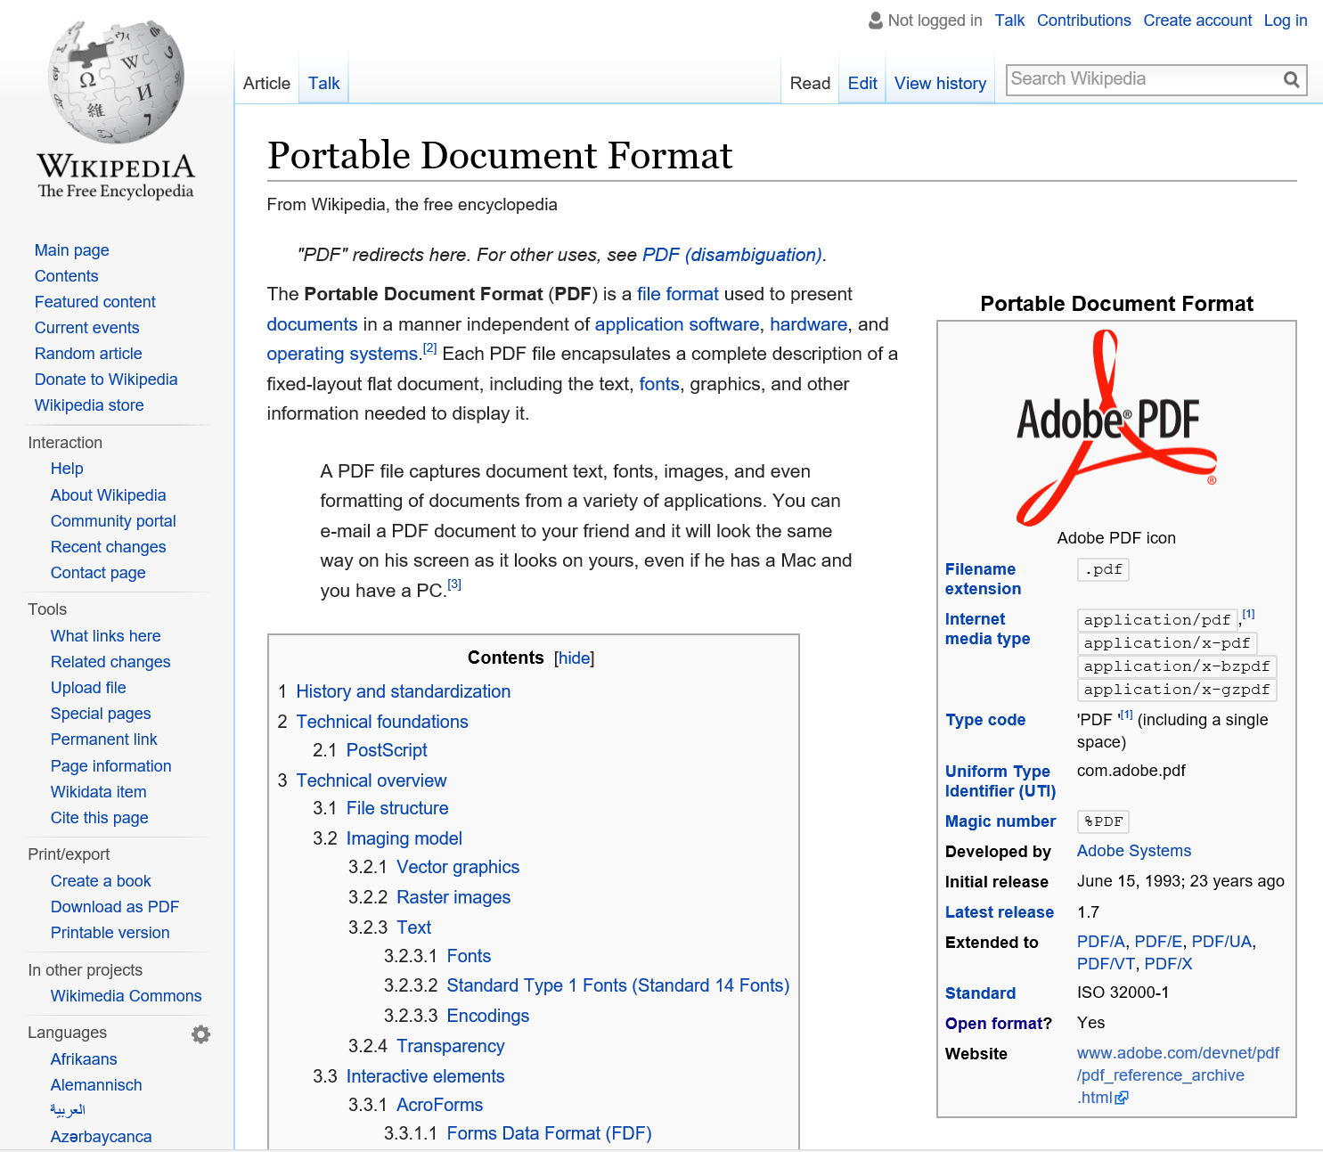

Slide 48


http://partners.adobe.com/public/developer/support/topic_legal_notices.html

Slide 49
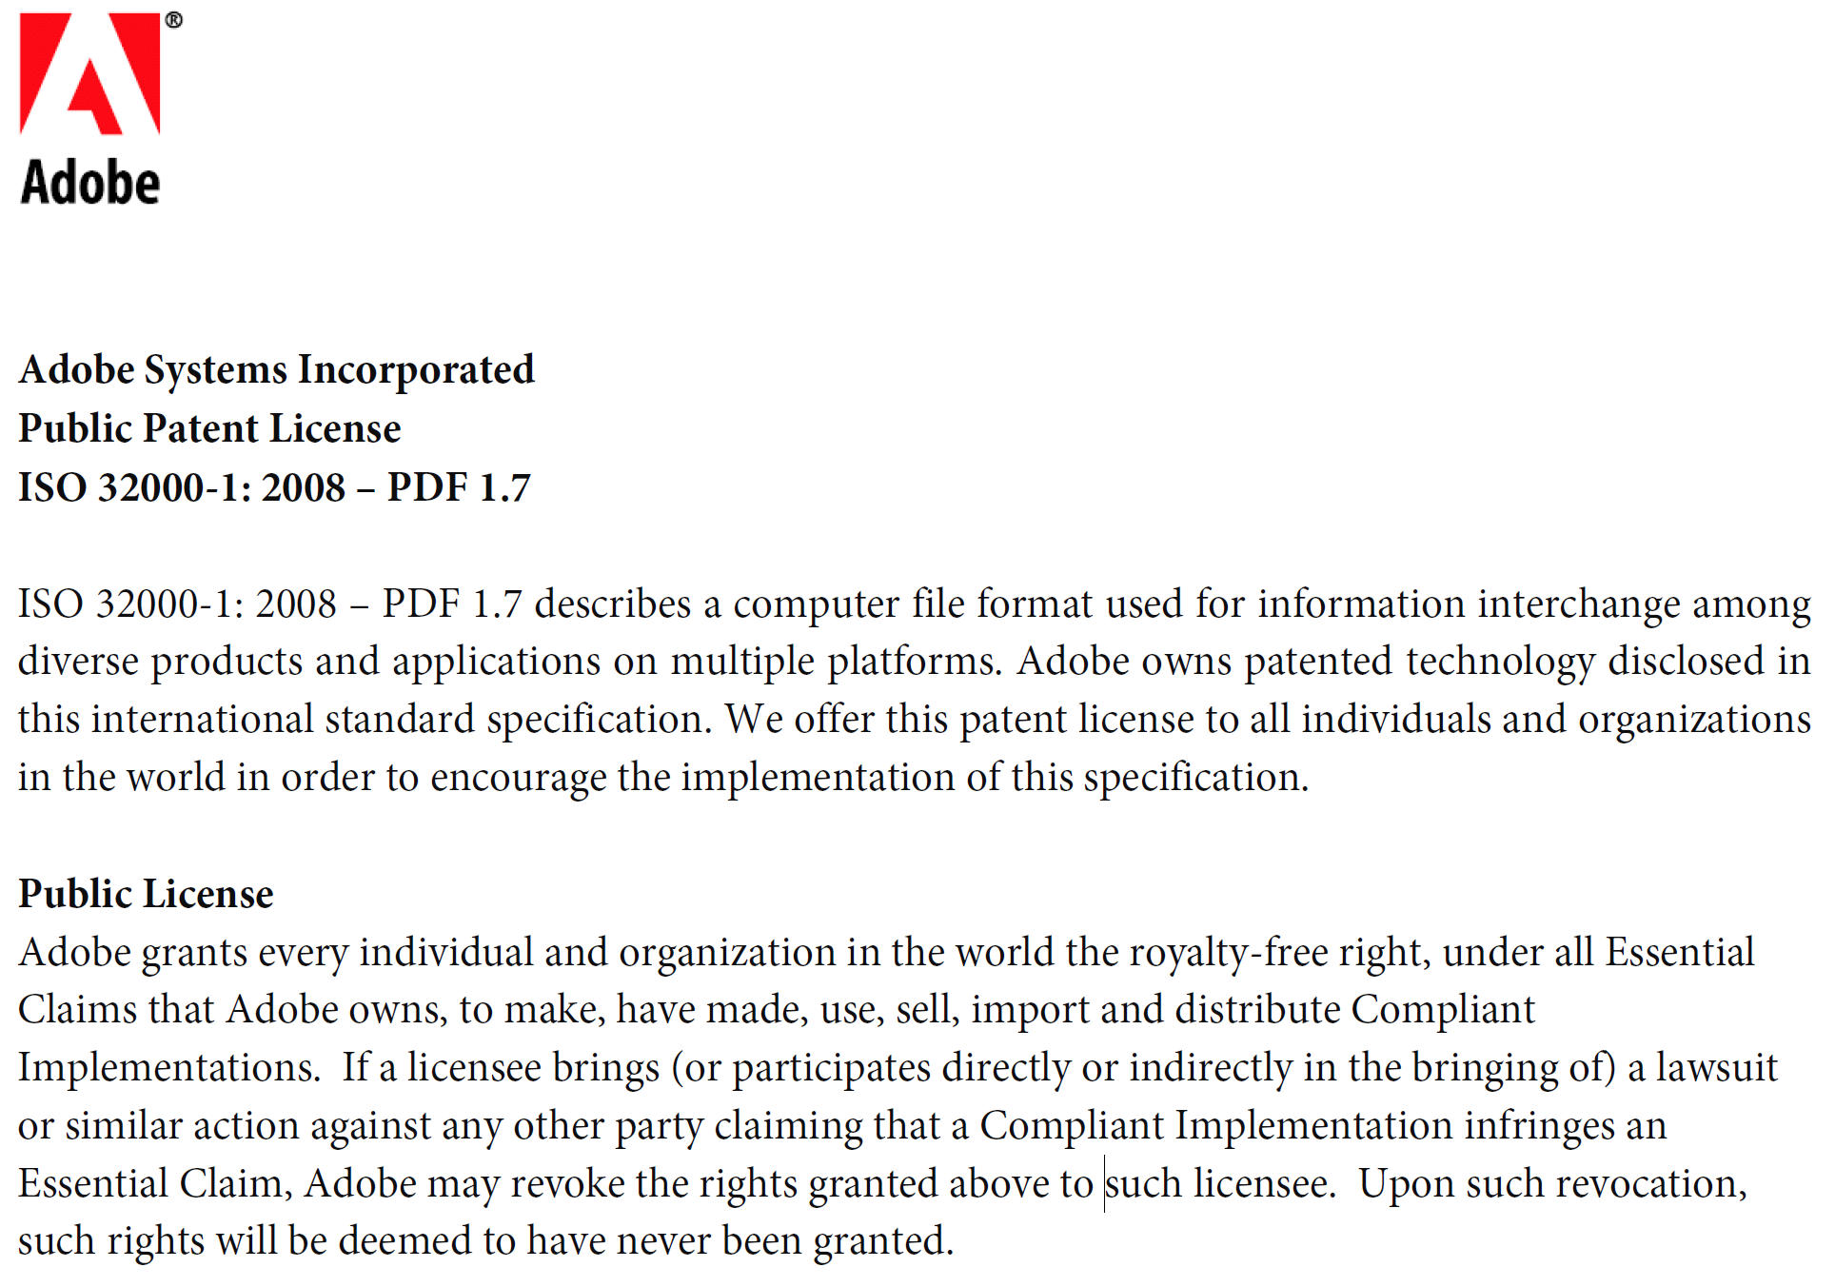

Slide 50
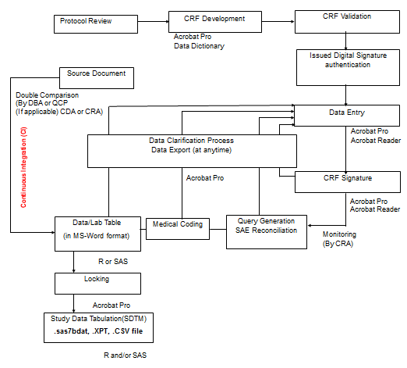
New Flow for Data Management

Slide 51
기존 방식 장·단점 비교
 | 자체 개발 | 구매 (서버 또는 서비스)
대표적 예 | 외국의 대규모 1상 기관 (라이덴대학, 셀러리온) 메디크로스타(가톨릭) iCreat(한국정부) | 현재 대부분의 경우 TrialOne(서울대병원)
장점 | 성공시 다른 곳에 판매 가능 (라이덴대학 -> Promasys) 매우 대규모에 유리 | 빨리 서비스를 시작할 수 있다. 개발 비용이 들지 않는다. 소규모에 유리
단점 | 고비용, 시간, 완성도(validation 및 인증) 에 문제가 많음 | 단가가 비쌀 수 있다. 기술지원이 어려울 수 있다.

Slide 52
구매 (서버, 웹 서비스) 방식 비교
 | 서버-클라이언트 방식 | 웹 방식
대표적 예 | Promasys ClinTrial(Phase forward) Promasys DMSys TrialOne | Medidata Rave Medrio REDCap OpenClinica
장점 | 빠르다 보안이 우수 건당 비용을 내지 않으므로 대규모에 유리 | 기존 web browser를 사용하기 때문에, 별도의 user Interface program이 필요가 없다. 유지보수가 쉽다.
단점 | 서버를 관리해야 한다. (IT인력 및 서버유지비용 큼) | 사용료를 지속적으로 내야한다.

Slide 53
기존 DB 방식과 PDF CRF(No DB) 방식 비교
 | 기존 DB 방식 | PDF CRF 방식 (No DB)
구성요소 | Hardware + OS + DBMS + Application Software + SAS | Adobe Acrobat + R (+ SAS) CDISC 표준 사용
장점 | 기존 IT인력의 일자리 창출(?) 기존 규정에 잘 맞는다. | 서버 (웹서버, DB서버 DBMS)와 복잡한 프로그래밍이 필요 없음 시간도 짧게 소요됨 Output(CSR Appendix Table & SDTM) 을 자동으로 실시간 생성함(Continuous Integration)
단점 | 비용과 시간(+2개월)이 많이 소모된다. (6만불~20만불/건/년) | 기존 방식을 선호하는 대부분의 사람들에 의한 반대(편견, 선입견)

Slide 54
Flow for Statistical Analysis
01
02
03
통계분석계획
통계분석진행
통계분석결과
Statistical analysis plan (SAP)
계획서 작성 후, DM Locking 이전, 분석 전에 SAP를 작성
임상시험 평가지표(Primary Outcome)에 대한 기술
SAP 작성이 완료되면 내부 검토 및 시험책임자가 검토 후 의뢰자의 최종 승인
Statistical programming, analysis and publication
분석을 위한 모든 통계 분석의 SAS script, R script는 검증된 것을 사용
재현가능한 분석이 될 수 있도록 세부적인 통계 프로그래밍 방법을 기록하여 소스 코드와 함께 서버에 저장
Statistical analysis report (SAR)
SAR은 SAP의 내용을 충실히 반영해야 하며, SAP와 다른 통계 분석이 사용될 경우 그 이유와 내용을 상세히 기술
04
05
통계분석 자료관리
부록문서
Softwares
SAS R Git (NONMEM, Phoenix WinNonLin, Clinical Trial Simulator)
Essential documentation and archiving
자료가 정확하고 오류 없이 처리될 수 있도록 충분한 문서화가 GCP의 원칙에 따라 이루어져야 함.
이를 위하여 최소한 다음과 같은 문서가 필요. (SAP, Audit Trail Documentation)
Appendix

Slide 55
Reproducible, Seamless Workflow
기존
CRF 개발 및 입력 (Web)
DB에서 자료 추출 후 각종 validation →
오류 교정 →
확인
R에서 자료 변형 →
WNL에서 비구획 분석 →
SAS에서 통계 분석
Word, Excel, SigmaPlot 등을 활용하여 표, 그림 및 보고서, 부록 작성
개선
CRF 개발 및 입력 (PDF)
PDF에서 자료 추출 후:
R에서 자료 변형, 비구획분석, 통계분석 및 표, 그림 작성 / 보고서 초안 및 부록 작성 →
원본 CRF와 최종 결과물을 비교하며 오류 교정 및 확인

Slide 56
감사합니다.
Thank you for your attention.

Slide 57
References
CENTER FOR DRUG EVALUATION AND RESEARCH, Approval Package 202429Orig1s000 https://www.accessdata.fda.gov/drugsatfda_docs/nda/2011/202429Orig1s000Approv.pdf
https://www.accessdata.fda.gov/drugsatfda_docs/nda/2011/202429Orig1s000ClinPharmR.pdf
https://www.accessdata.fda.gov/drugsatfda_docs/nda/2011/202429Orig1s000PharmR.pdf

